Slide 1


GBME Probability and Statistics | Spring 2024
Lecture 01
Lecture 01
Course overview
CHOONG-WAN WOO | COCOAN lab | http://cocoanlab.github.io

Slide 2

Lecture 01
Introduction
Lab webpage
https://cocoanlab.github.io/
CHOONG-WAN WOO | COCOAN lab | http://cocoanlab.github.io

Slide 3
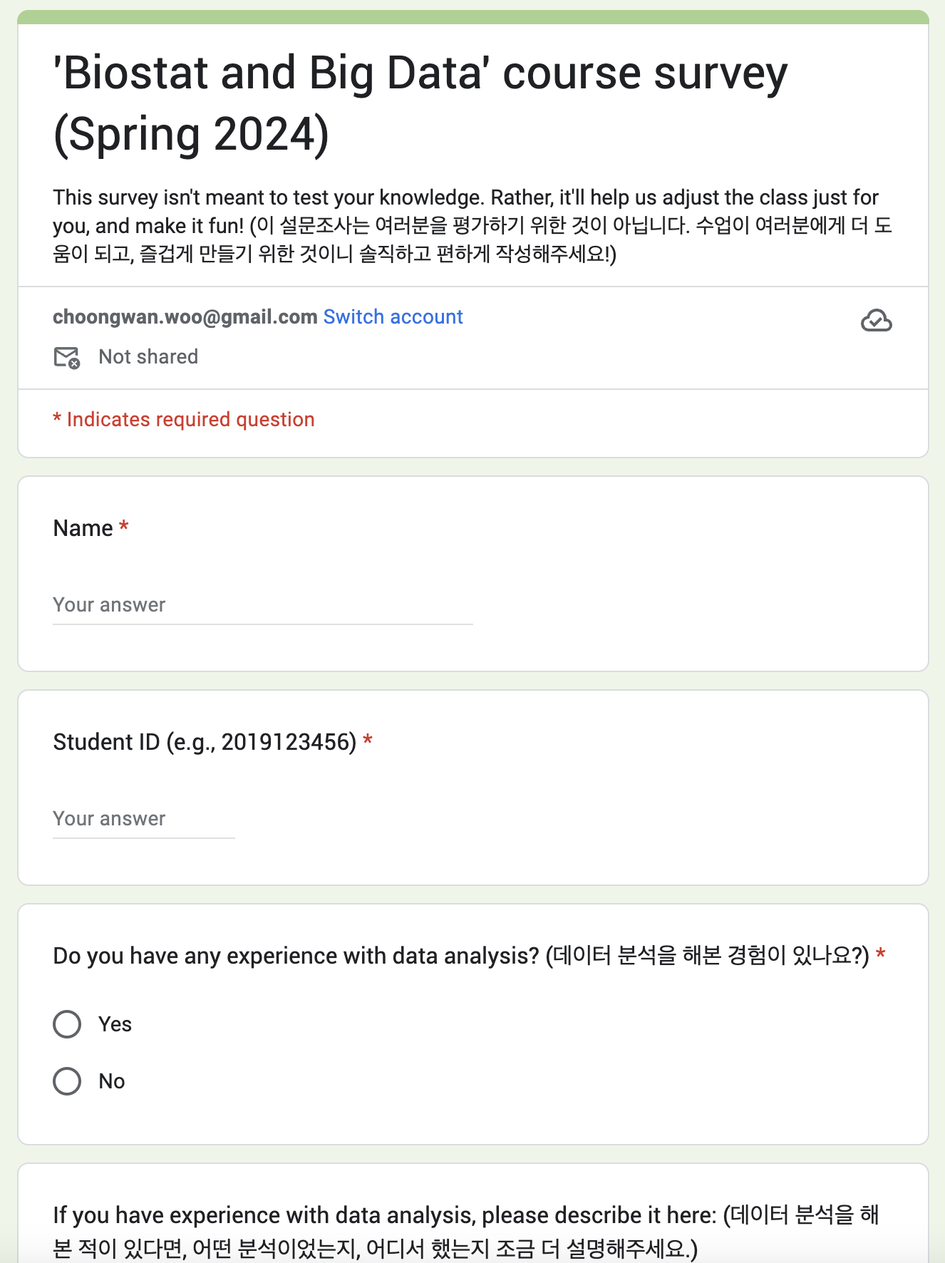
Lecture 01
Survey
Please complete this before next week class (3/13):
https://forms.gle/HJPyX8y4RryYWZai8
CHOONG-WAN WOO | COCOAN lab | http://cocoanlab.github.io

Slide 4
Lecture 01
Course overview
Biostats and Big data (previously GBME’s Probability and Statistics)
Class code: GBE 3064
Intro Stats
Textbook: "Stats: Data and Models" by De Veaux, Velleman, and Bock, Fourth Edition
Third edition also works!
CHOONG-WAN WOO | COCOAN lab | http://cocoanlab.github.io

Slide 5
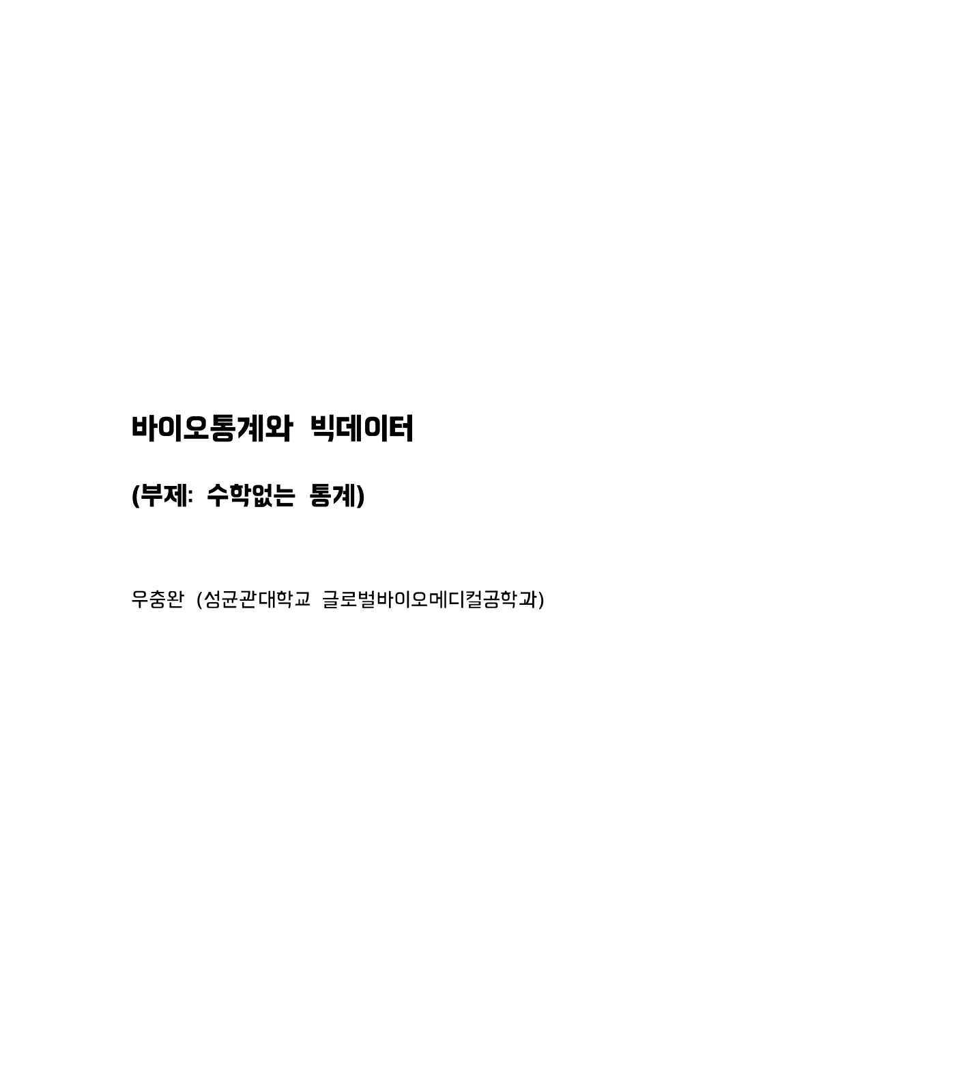
Lecture 01
Course overview
Biostats and Big data (previously GBME’s Probability and Statistics)
Class code: GBE 3064
Intro Stats
Textbook: "Stats: Data and Models" by De Veaux, Velleman, and Bock, Fourth Edition
Third edition also works!
And I recently wrote a textbook in Korean
I am sharing this for free!
Download: https://tinyurl.com/4kdx8thf
No cover, no design yet.. (if you want to help with the book design, let me know. ☺ )
CHOONG-WAN WOO | COCOAN lab | http://cocoanlab.github.io

Slide 6
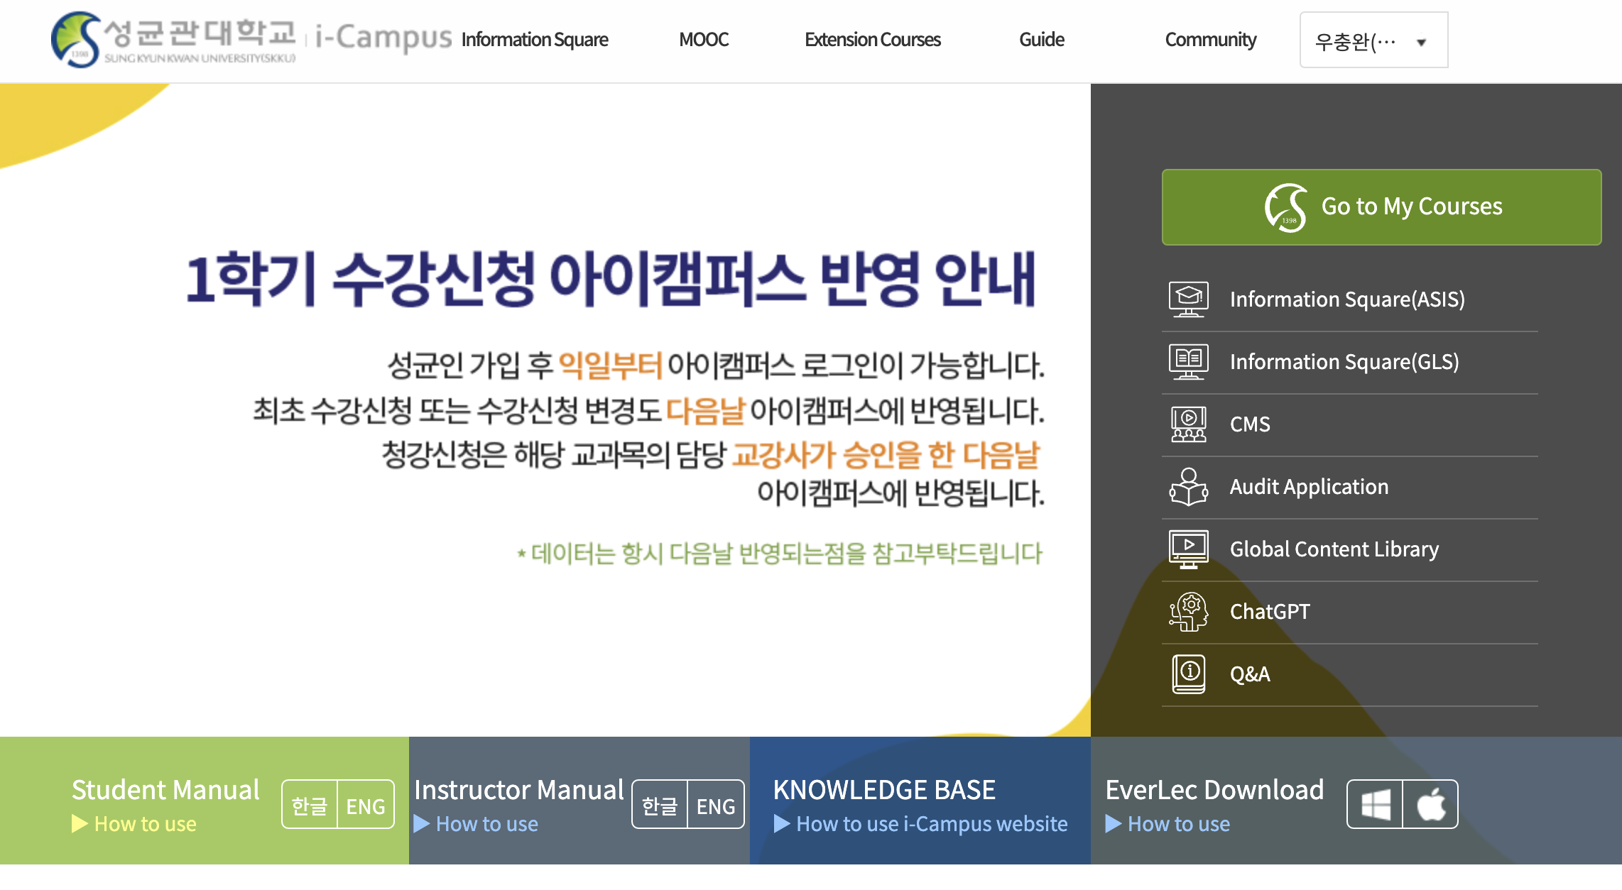
Lecture 01
For communications!
iCampus
and email (choongwan.woo@gmail.com)
CHOONG-WAN WOO | COCOAN lab | http://cocoanlab.github.io

Slide 7
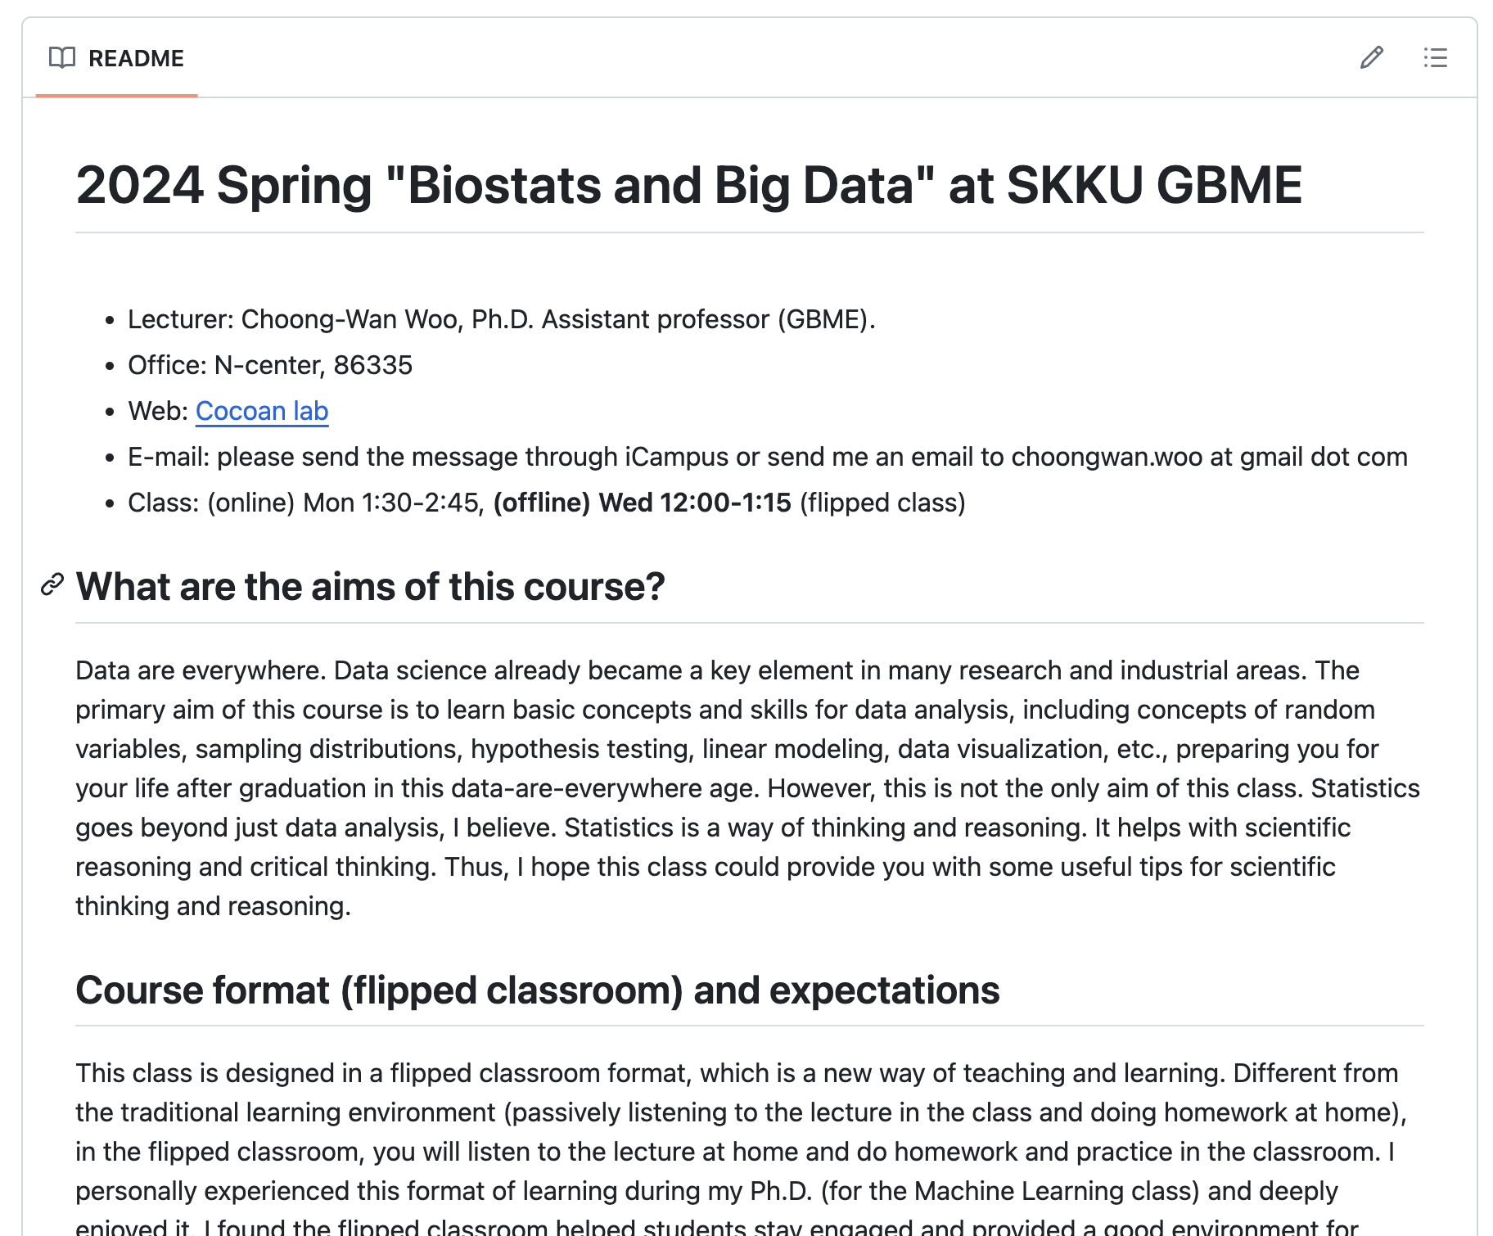
Lecture 01
Syllabus
Our class website: https://github.com/wanirepo/Stats_2024Spring
README.md is the syllabus.
Let’s visit the website and read the syllabus together.
CHOONG-WAN WOO | COCOAN lab | http://cocoanlab.github.io

Slide 8
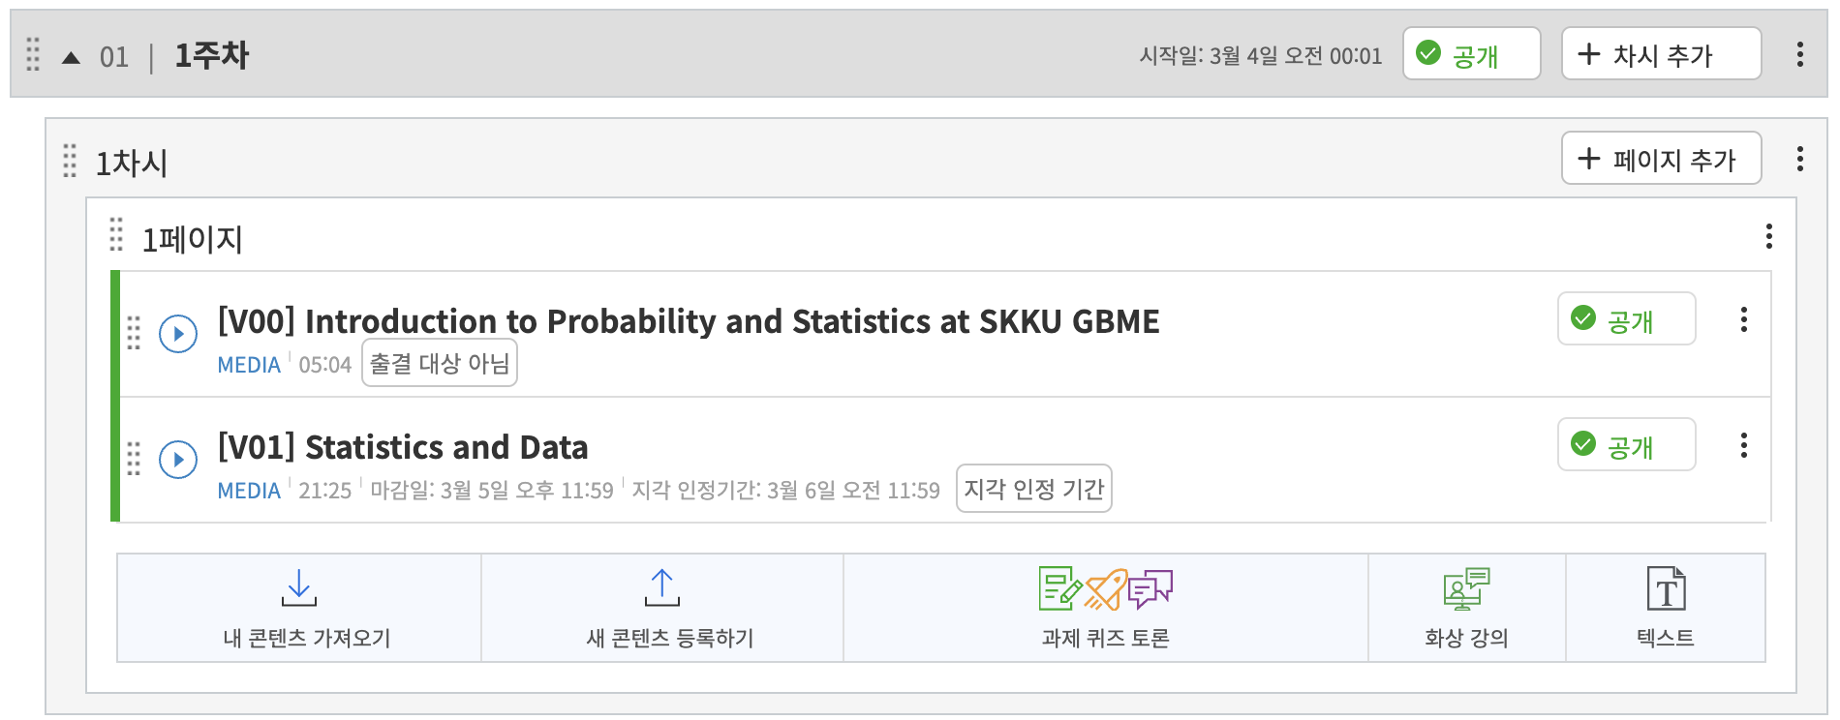
Lecture 01
Watching lecture videos
I will upload lectures like this every week.
There will be two types of lectures:
1) Short lectures in English
2) Long lectures in Korean explaining the short English lectures
For those who do not use Korean, you can watch 1). It covers all the contents.
But if you know Korean, please watch 2), which has more in-depth explanations.
CHOONG-WAN WOO | COCOAN lab | http://cocoanlab.github.io

Slide 9
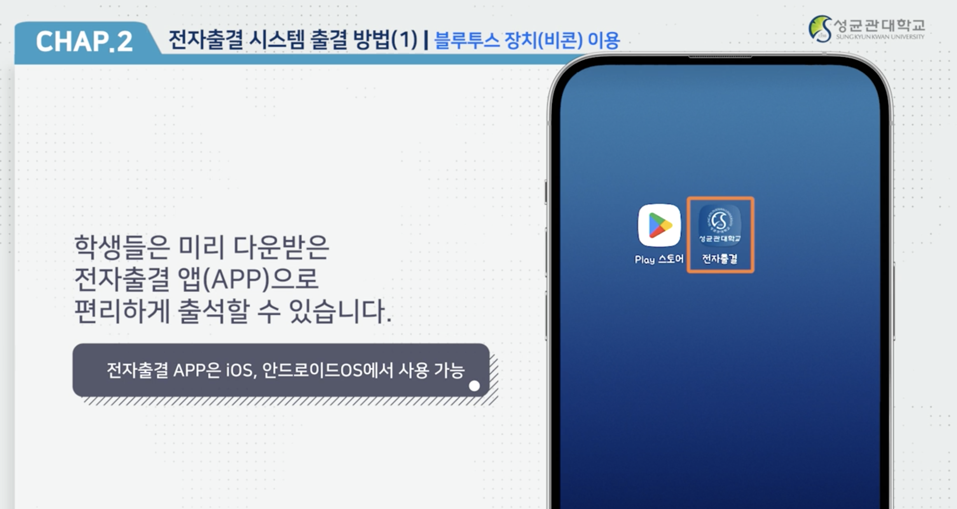
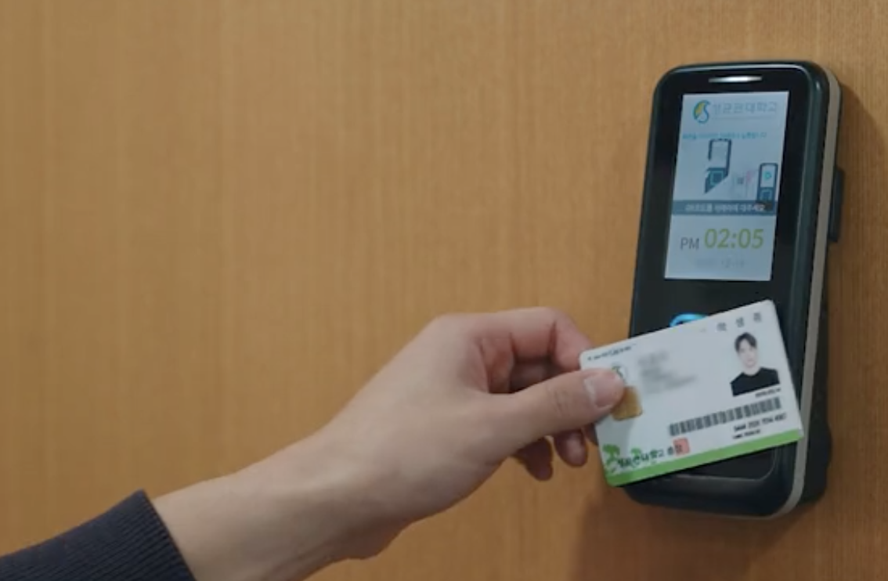
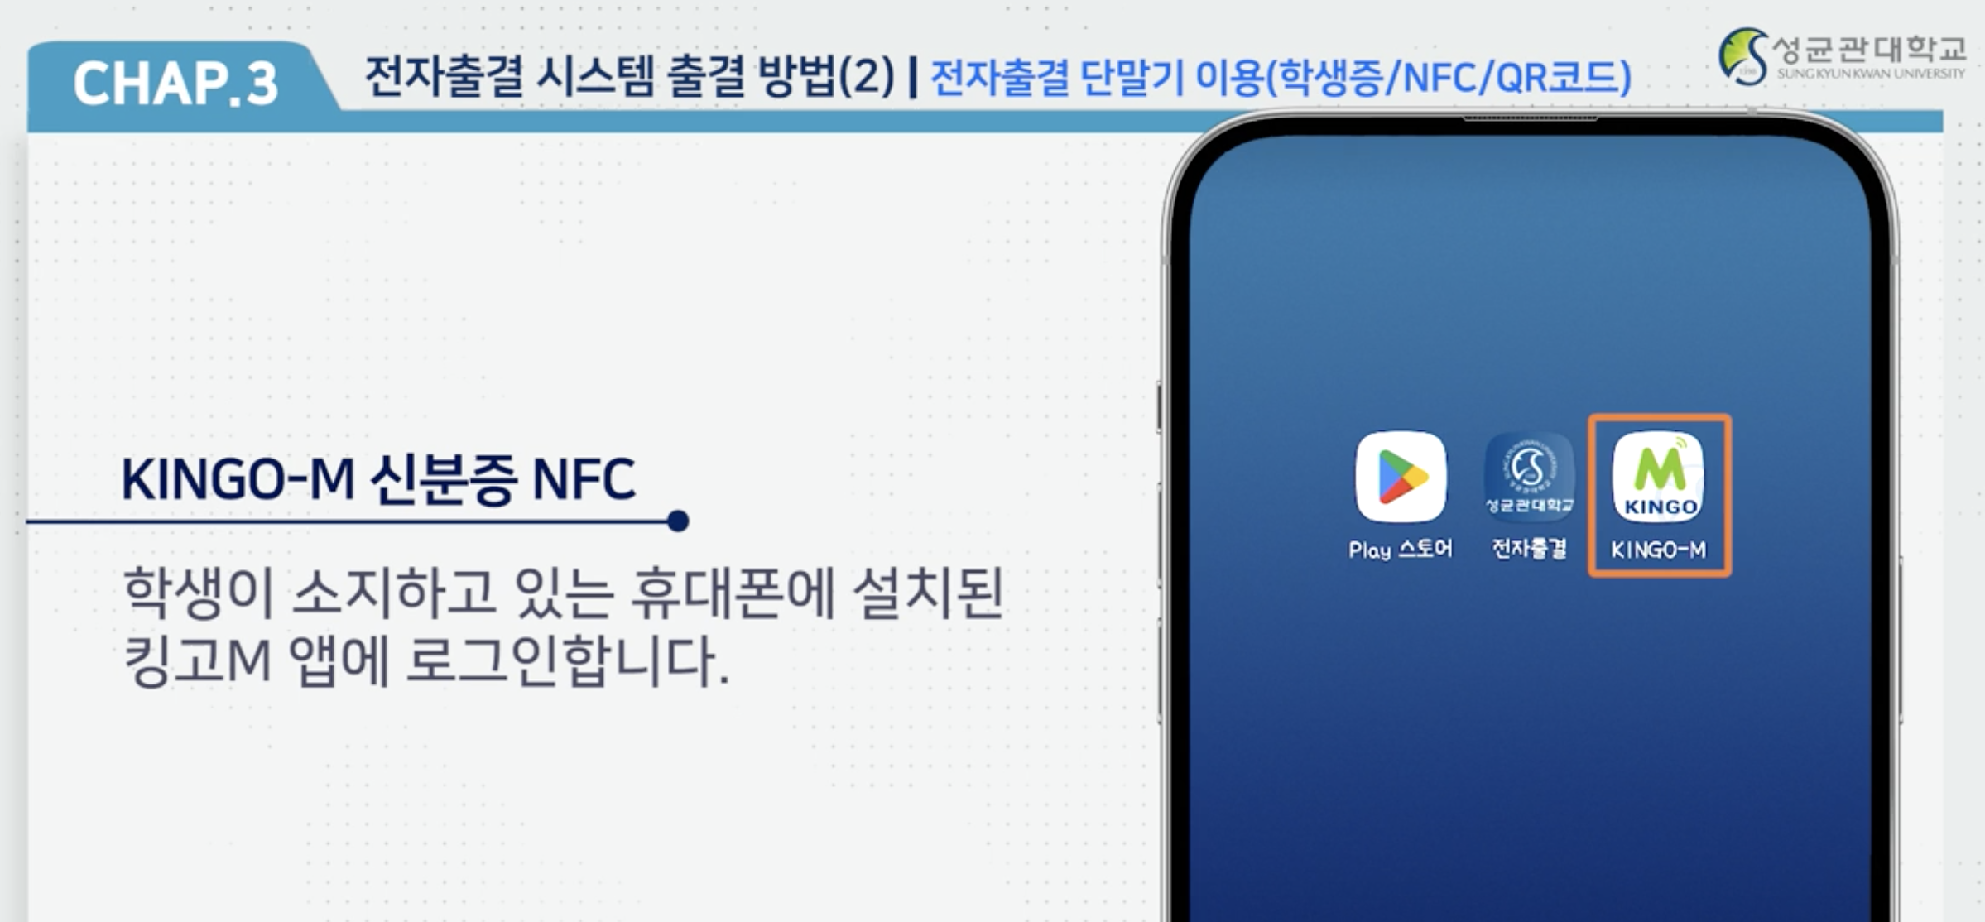
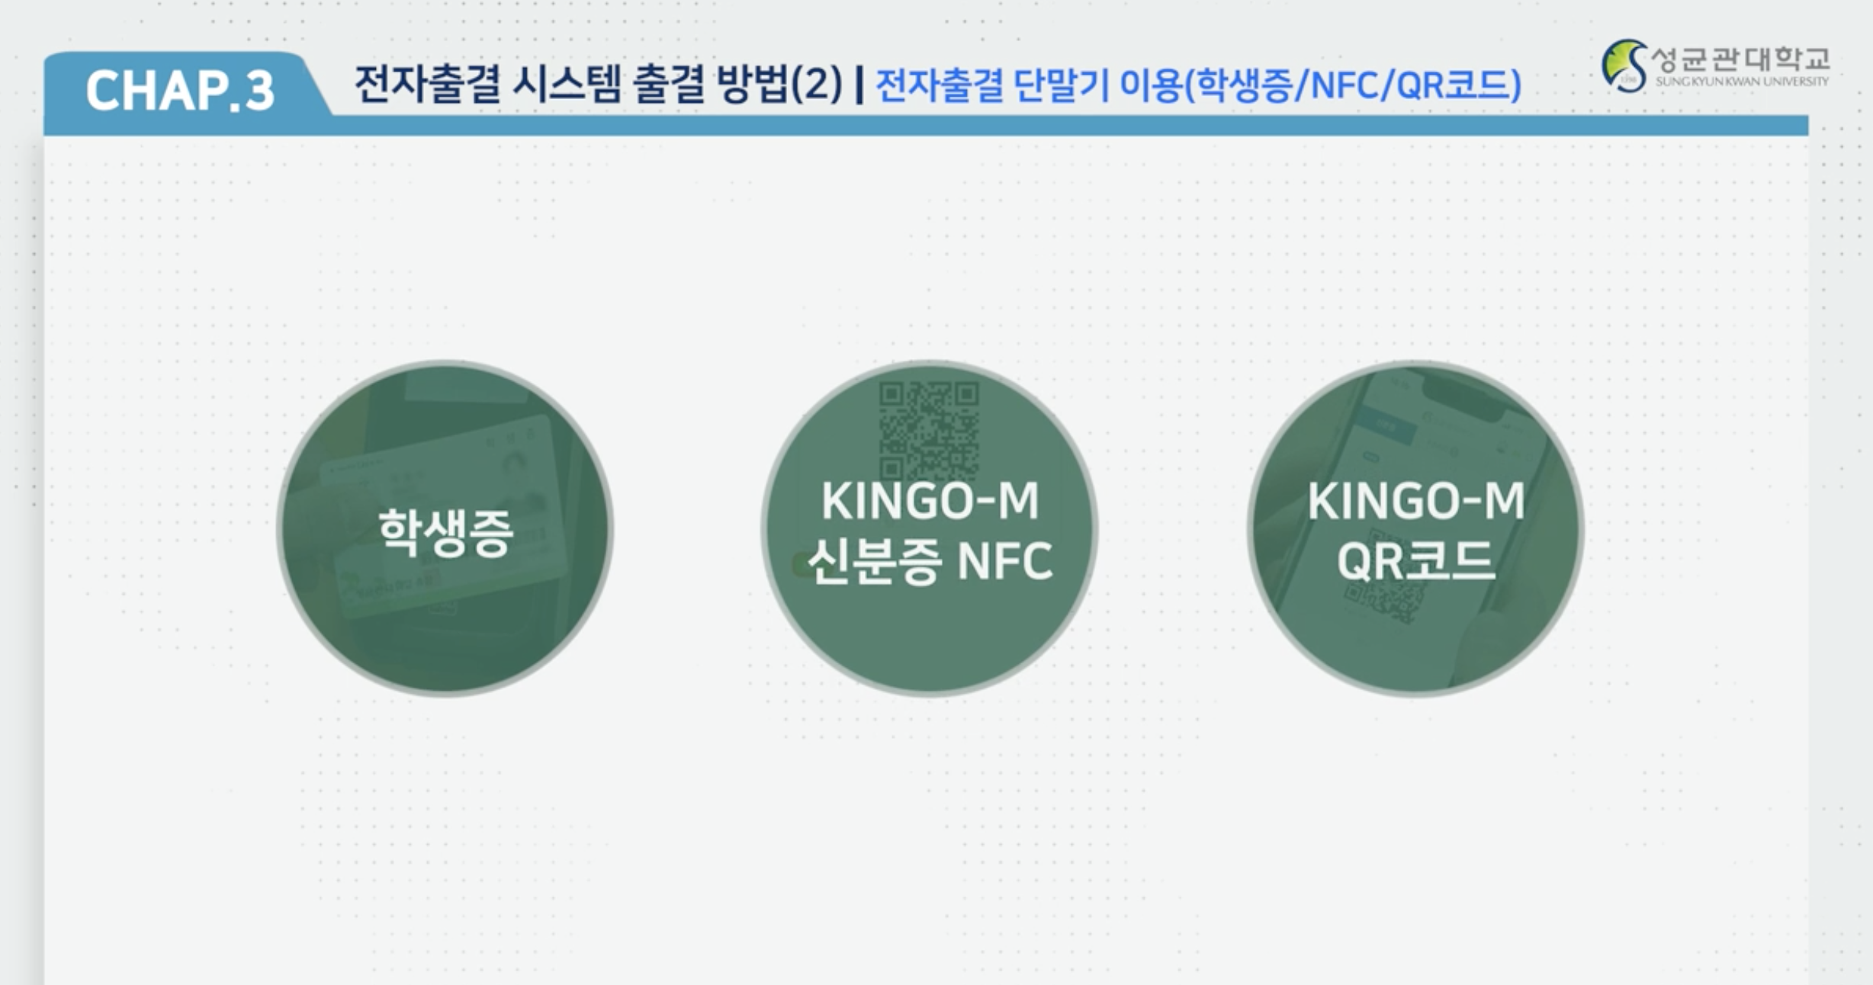
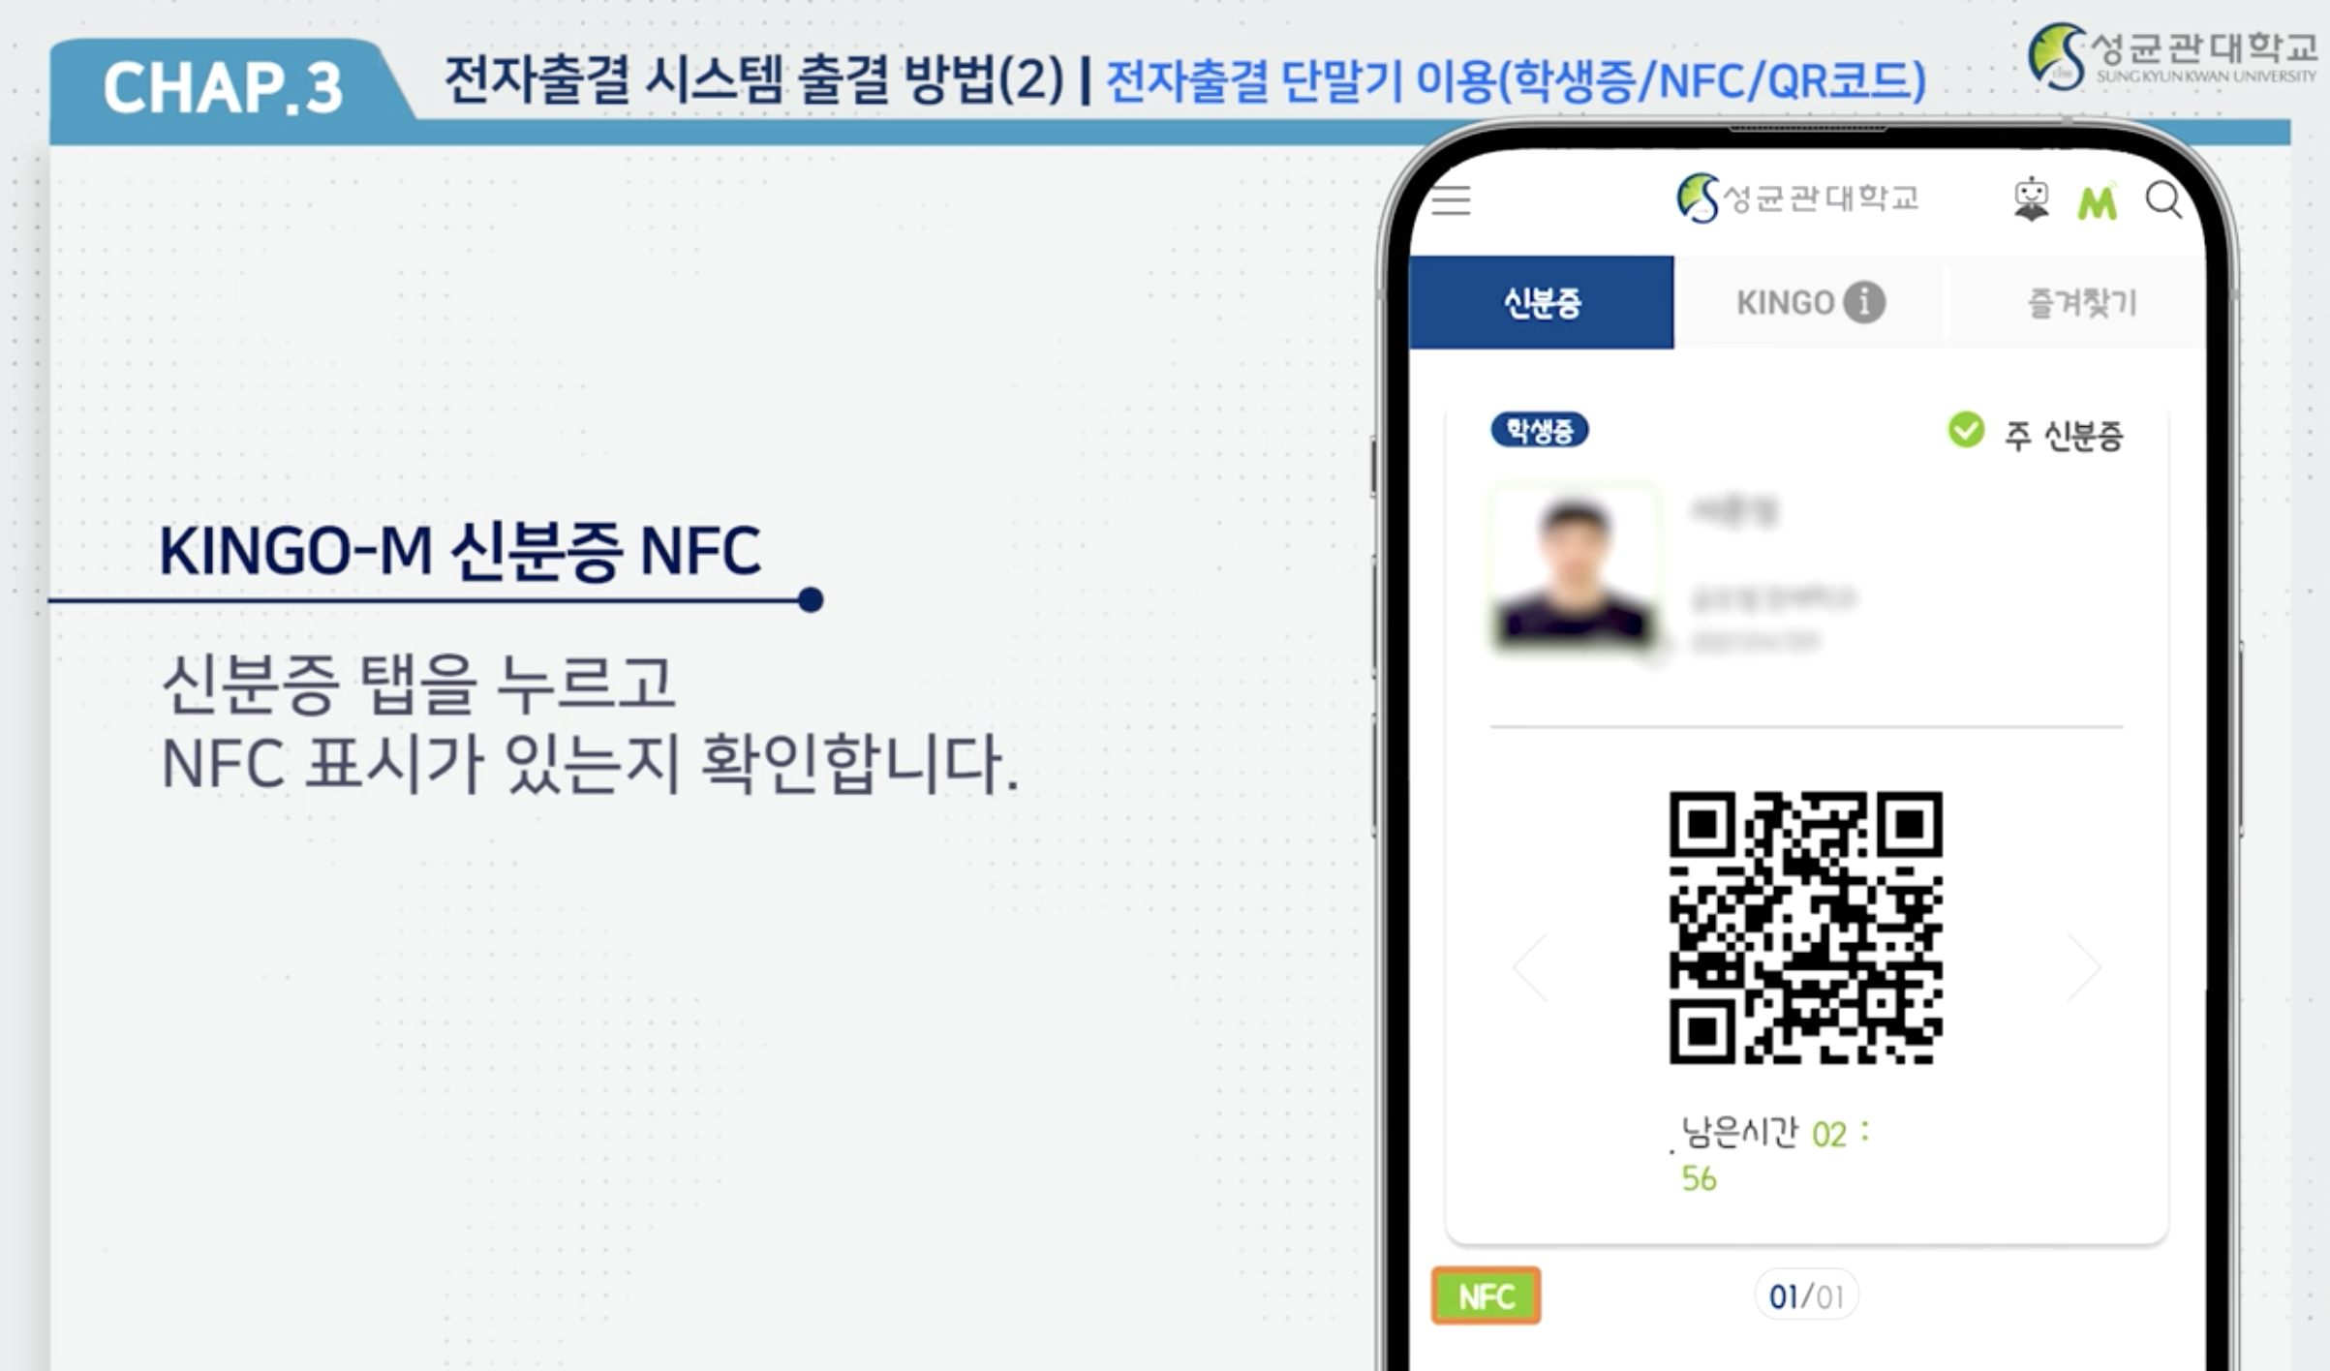
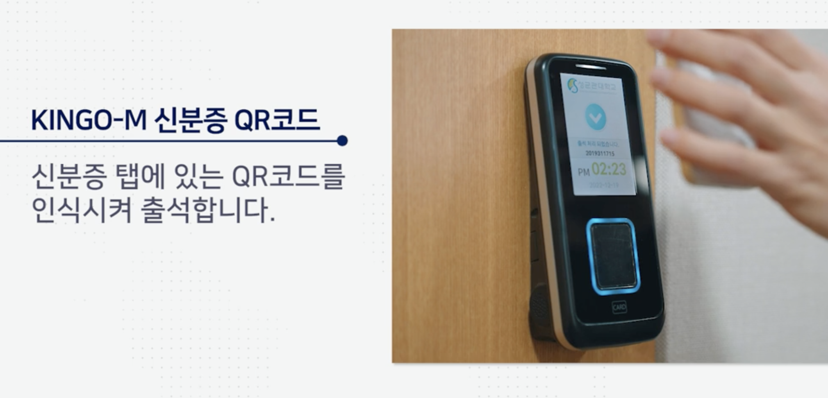
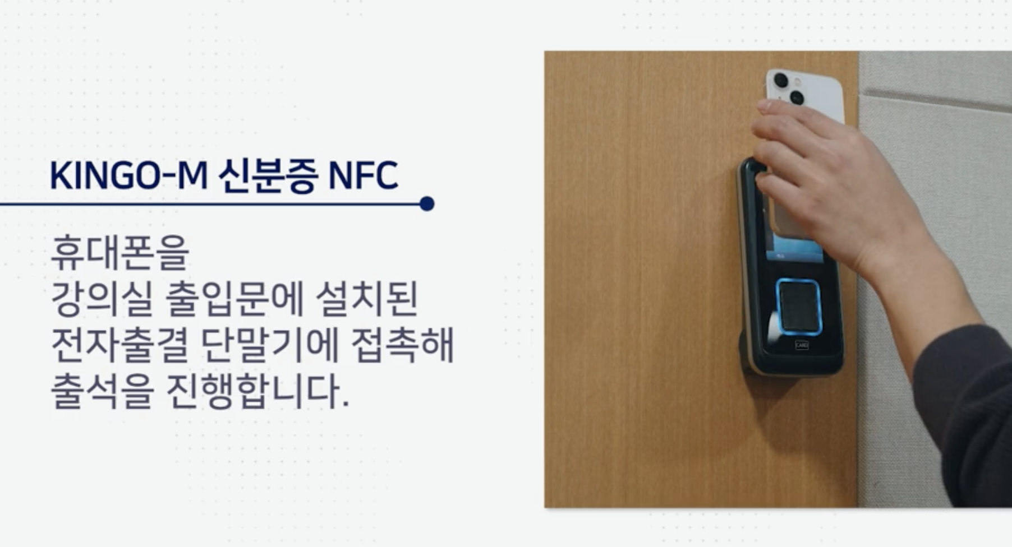
Lecture 01
Smart attendance
출석: 강의시간 5분 전~ 시작 후 10분
지각: 강의시간 +10분 ~ +40분
결석: +40분 이후 또는 미참석
CHOONG-WAN WOO | COCOAN lab | http://cocoanlab.github.io

Slide 10
Lecture 01
Team activity
Each class, you will form new teams depending on where you sit
4-5 members per team
CHOONG-WAN WOO | COCOAN lab | http://cocoanlab.github.io

Slide 11
Lecture 01
To-do before the next class
Survey before the next class (3/6): https://forms.gle/HJPyX8y4RryYWZai8
Watch the first two week’s lecture
Next class: 3/13 Monday 1:30 PM here at 86120
CHOONG-WAN WOO | COCOAN lab | http://cocoanlab.github.io

